Slide 1
Software Construction Laboratory CS35L – Lab 1
Course Webpage: https://web.cs.ucla.edu/classes/fall18/cs35L/index.html
TA: Zhiyi Zhang
Email: zhiyi@cs.ucla.edu
Webpage: https://zhiyi-zhang.com

Slide 2
Session 3-1
Software installation and Decompressing Files
Compilation and Make
Diff and Patch

Slide 3
Sign up for Assignment 10
Step 01 (Optional): team up with another student
Step 02: select a topic from the given resources https://web.cs.ucla.edu/classes/fall18/cs35L/assign/assign10.html
Step 03: select a time slot for your presentation
Step 04: go to the google slides to sign up https://docs.google.com/spreadsheets/d/1jVrbevYE8JCxZWVvMmsoU__QeSR6N2y-_3o3bGIAX1s/edit?usp=sharing
Deadline: This Friday 10/19/2018 11:55pm

Slide 4
About the presentation
Time
For one student presentation, about 10 minutes
For two students team, about 15 minutes
Requirements
Technical Material, e.g., Algorithm, Methodology, Strategy
Q&A

Slide 5
Software Installation and Decompressing Files

Slide 6
Software Installation
Windows and MacOS
Windows/MacOS Installer
Others
Linux
apt-get (Advanced Package Tool): Debian, Ubuntu, others
rpm (Redhat Package Management): Red Hat
other package manager
tarball file
from source code
Popular Tools: Waf, Make, etc.
Notes:
Advanced Package Tool, or APT, is a free software user interface that works with core libraries to handle the installation and removal of software on Debian, Ubuntu and other Linux distributions.

Slide 7
Decompress Tarball File
Generally, you receive Linux software in the tarball format (.tgz) or (.gz)
Decompress file in current directory:
$ tar –xzvf filename.tar.gz
Option –x: --extract
Option –z: --gzip
Option –v: --verbose
Option –f: --file
Notes:
gzip is a file format and a software application used for file compression and decompression.

Slide 8
Compilation and Make

Slide 9
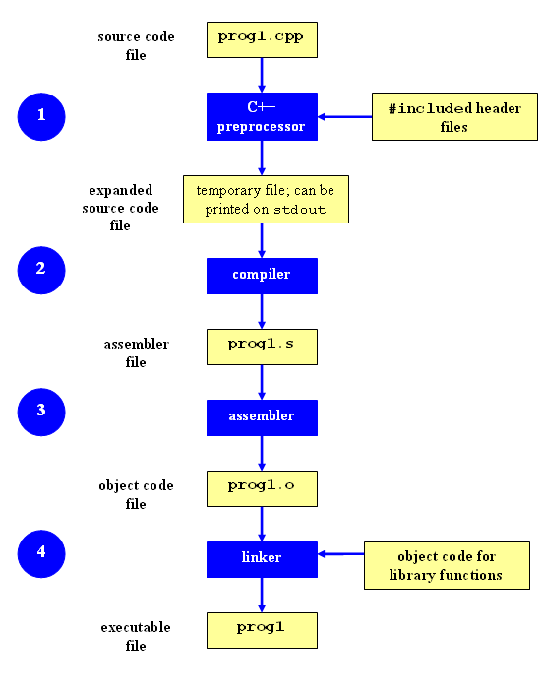
Compilation Process
Preprocessing (Preprocessed Code)
Include Headers
Replace symbolic constants
Compilation (Assembly Code)
Preprocessed code is translated to assembly instructions specific to the target processor architecture
Assembly (Object Code)
To object code. The output consists of actual instructions to be run by the target processor.
Linking (Executable File)
Link the missing pieces of the program, e.g., dynamic link libraries
Notes:
g++ -E example.cpp
Will output the preprocessed code
g++ -S example.cpp
Will generate the assembly instructions
g++ -c example.cpp
Will generate object code
hexdump example.o
g++ -o example example.cpp

Slide 10
Command-Line Compilation
shop.cpp
#includes shoppingList.h and item.h
shoppingList.cpp
#includes shoppingList.h
item.cpp
#includes item.h
How to compile?
g++ -Wall shoppingList.cpp item.cpp shop.cpp –o shop

Slide 11
What if…
We change one of the header or source files?
Rerun command to generate new executable
We only made a small change to item.cpp?
Not efficient to recompile shoppinglist.cpp and shop.cpp
Solution: avoid waste by producing a separate object code file for each source file
g++ -Wall –c item.cpp… (for each source file)
g++ item.o shoppingList.o shop.o –o shop (combine)
Less work for compiler, saves time but more commands

Slide 12
What if…
We change item.h?
Need to recompile every source file that includes it & every source file that includes a header that includes it. Here: item.cpp and shop.cpp
Difficult to keep track of files when project is large
Windows 7 ~40 million lines of code
Google ~2 billion lines of code
=> Make

Slide 13
Make
Utility for managing large software projects
Compiles files and keeps them up-to-date
Efficient Compilation (only files that need to be recompiled)

Slide 14
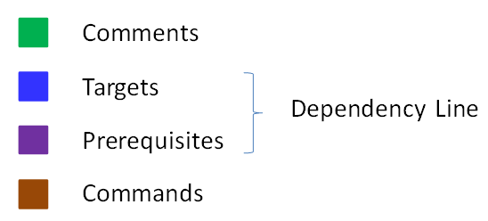
Makefile Example
# Makefile - A Basic Example
all : shop #usually first
shop : item.o shoppingList.o shop.o
g++ -g -Wall -o shop item.o shoppingList.o shop.o
item.o : item.cpp item.hpp
g++ -g -Wall -c item.cpp
shoppingList.o : shoppingList.cpp shoppingList.hpp
g++ -g -Wall -c shoppingList.cpp
shop.o : shop.cpp item.hpp shoppingList.hpp
g++ -g -Wall -c shop.cpp
clean :
rm -f item.o shoppingList.o shop.o shop
Rule

Slide 15
Build Process
configure
Script that checks details about the machine before installation
Dependency between packages
Creates ‘Makefile’
make
Requires ‘Makefile’ to run
Compiles all the program code and creates executables in current temporary directory
make install
make utility searches for a label named install within the Makefile, and executes only that section of it
executables are copied into the final directories (system directories)

Slide 16
Diff and Patch

Slide 17
Diff command to generate a patch
diff [original file] [updated file]
Understand the output:
Line number, e.g., 12,15
Operations: c (replace), d (delete), a (append)
Create a patch:
diff [original file] [updated file] > [blabla].patch

Slide 18
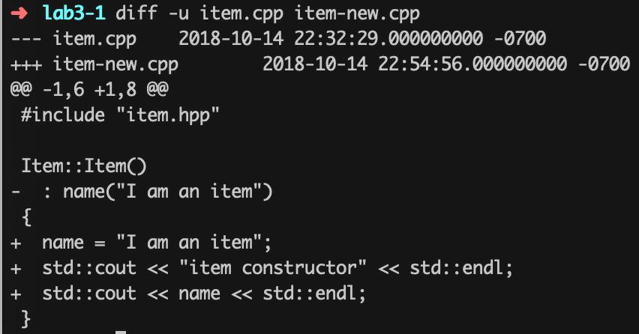
Unified Format in diff
diff –u [original file] [updated file]
--- path/to/original_file
+++ path/to/modified_file
@@ -l, s _l, s @@
@@ begin of a hunk
l: beginning of a hunk
s: number of lines the change hunk applies to for each file
A line with a
- sign was deleted from the original
+ sign was added to the original
stayed the same
Notes:
The diff command can also output the differences in another format: the unified format. This format is more compact, as it omits redundant context lines and groups things like line number instructions. However, this format is currently only supported by GNU diff and patch.

Slide 19
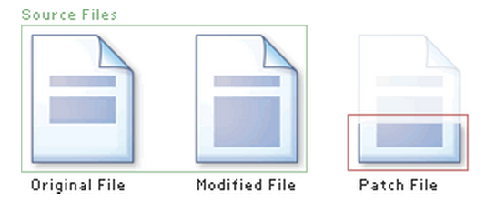
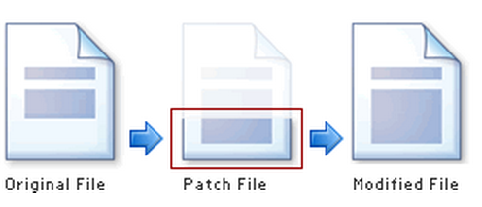
Applying the Patch
Syntax: patch [original file] -i [patch file] -o [updated file]
patch command will apply the patch file to the original file and create an updated file

